Slide 1

CSE 473: Pattern Recognition

Slide 2
Unsupervised Learning:
Clustering

Slide 3
What is Cluster Analysis?
Finding groups of objects such that the objects in a group will be similar (or related) to one another and different from (or unrelated to) the objects in other groups
Inter-cluster distances are maximized
Intra-cluster distances are minimized

Slide 4
Applications
Understanding
  Biological taxonomy
  Group related documents for browsing (e. g., folders)
  Group genes and proteins that have similar functionality
  Group stocks with similar price fluctuations
Summarization
  Reduce the size of large data sets
Data Compression
  Vector quantization
Finding nearest neighbor

Slide 5
Applications .. .
Hypothesis generation
  To infer some hypothesis
  Examples:
    ‘big companies invest overseas’
    ‘many BUET students are from Chittagong’
Hypothesis testing
  To verify an existing hypothesis
Prediction based on groups
  Predict unknown patterns

Slide 6
What is not Cluster Analysis?
Supervised classification
  Have class label information
Simple segmentation
  Dividing students into different registration groups alphabetically, by last name
Results of a query
  Groupings are a result of an external specification

Slide 7
Clustering Basis
Basic Concepts
a clustering criterion must first be adopted.
Different criteria lead to different clusters.

Slide 8
Notion of a Cluster can be Ambiguous
  Depending on the similarity measure, the clustering criterion and the clustering algorithm, different clusters may result. Subjectivity is a reality to live with from now on.

Slide 9
Notion of a Cluster can be Ambiguous
  Depending on the similarity measure, the clustering criterion and the clustering algorithm, different clusters may result. Subjectivity is a reality to live with from now on.
How many clusters?
Six Clusters
Two Clusters
Four Clusters

Slide 10
Notion of a Cluster can be Ambiguous
Let these animals to be clustered
  Blue shark, sheep, cat, Dog, Lizard, sparrow, viper, seagull, gold fish, frog, red mullet

Slide 11
  A real example
Blue shark,
sheep, cat,
dog
Lizard, sparrow, viper, seagull, gold fish, frog, red mullet
Two clusters
Clustering criterion:
How mammals bear
their progeny
Gold fish, red mullet, blue shark
Sheep, sparrow,
dog, cat, seagull,
lizard, frog, viper
Two clusters
Clustering criterion:
Existence of lungs

Slide 12
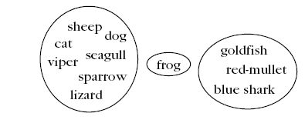
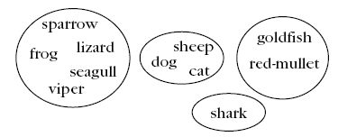
  A real example
Three clusters
Clustering criterion:
Their living
environment
Four clusters
Clustering criterion:
Bear progeny and Existence of lungs

Slide 13
Clustering Task Stages
  Feature Selection: Information rich features-Parsimony
  Proximity Measure: This quantifies the term similar or dissimilar.
  Clustering Algorithm: This consists of the set of steps followed to reveal the structure, based on the similarity measure and the adopted criterion.
  Validation of the results.
  Interpretation of the results.

Slide 14
Types of Features
With respect to their domain
  Continuous (the domain is a continuous subset of ℜ).
  Discrete (the domain is a finite discrete set).
    Binary or dichotomous (the domain consists of two possible values).
With respect to the relative significance of the values they take
  Nominal (the values code states, e.g., the home district of an individual).
  Ordinal (the values are meaningfully ordered, e.g., the rating of the services of a hotel (poor, good, very good, excellent)).
  Interval-scaled (the difference of two values is meaningful but their ratio is meaningless, e.g., temperature).
  Ratio-scaled (the ratio of two values is meaningful, e.g., weight).

Slide 15
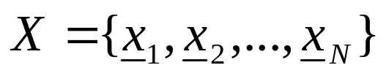
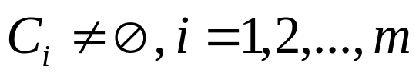
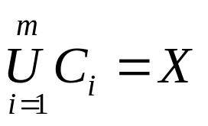
Clustering Definitions
Hard Clustering: Each point belongs to a single cluster
    Let
    An m-clustering R of X, is defined as the partition of X into m sets (clusters), C₁, C₂,…,C_{m}, so that
  In addition, data in C_{i} are more similar to each other and less similar to the data in the rest of the clusters.

Slide 16


Clustering Definitions
  Fuzzy clustering: Each point belongs to all clusters up to some degree.
  A fuzzy clustering of X into m clusters is characterized by m functions
    is the representative of jth cluster

Slide 17
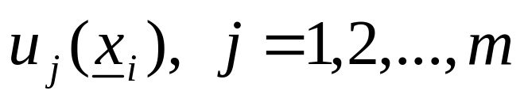
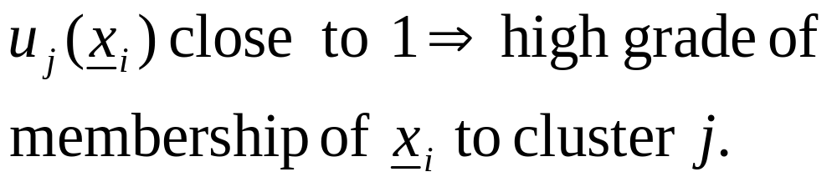
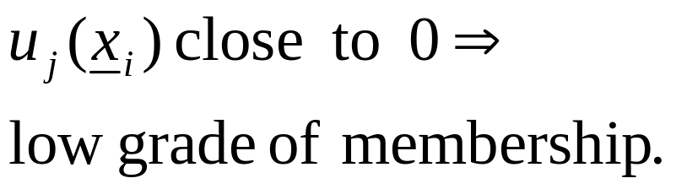
Clustering Definitions
  These are known as membership functions.
  Thus, each x_{i} belongs to any cluster “up to
  some degree”, depending on the value of

Slide 18
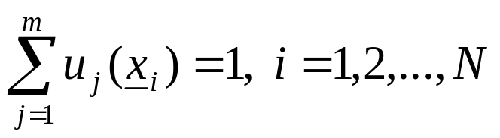
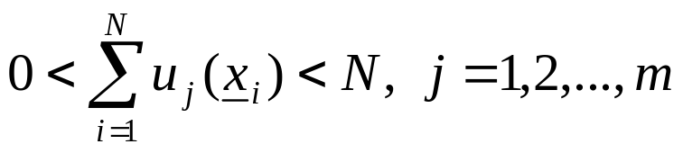
Clustering Definitions
  Fuzzy clustering: Each point belongs to all clusters up to some degree.
  A fuzzy clustering of X into m clusters is characterized by m functions
    is the representative of jth cluster

Slide 19
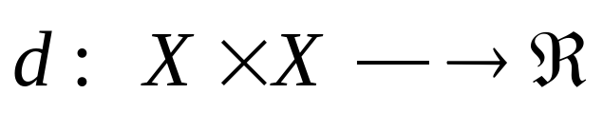
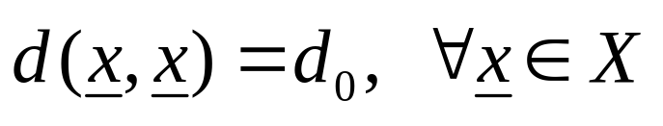
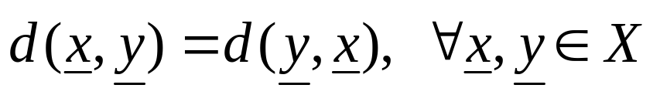
Proximity Measures
Between vectors
  Dissimilarity measure (between vectors of X) is a function
with the following properties

Slide 20
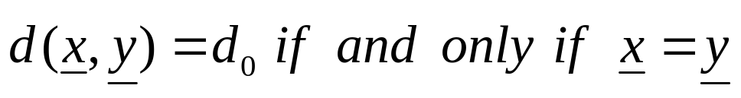
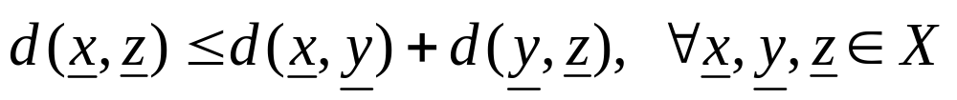
Proximity Measures
If, in addition
  (triangular inequality)
  d is called a metric dissimilarity measure.

Slide 21
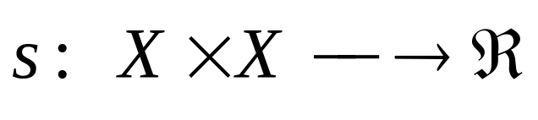
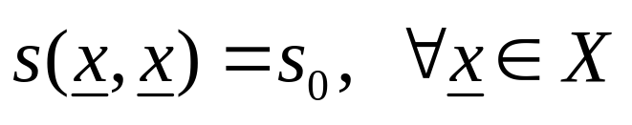
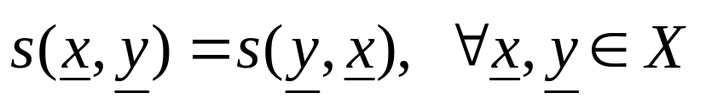
Proximity Measures
  Similarity measure (between vectors of X) is a function
with the following properties

Slide 22
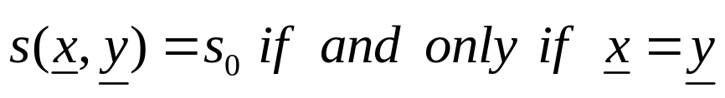
Proximity Measures
If, in addition
  s is called a metric similarity measure.

Slide 23
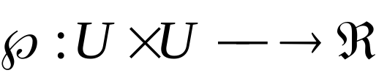
Proximity Measures
Between sets
Let D_{i} ⊂ X, i=1,…,k and U={D₁,…,D_{k}}
A proximity measure ℘ on U is a function

Slide 24
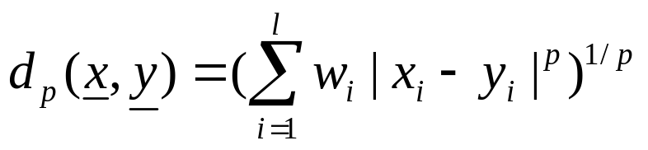
Proximity Measures Between Points/Vectors
Real-valued vectors
  Dissimilarity measures (DMs)
    Weighted l_{p} metric DMs
    Interesting instances are obtained for
      p=1 (weighted Manhattan norm)
      p=2 (weighted Euclidean norm)
      p=∞ (d∞(x,y)=max_{1≤i≤l} w_{i}|x_{i}-y_{i}| )

Slide 25
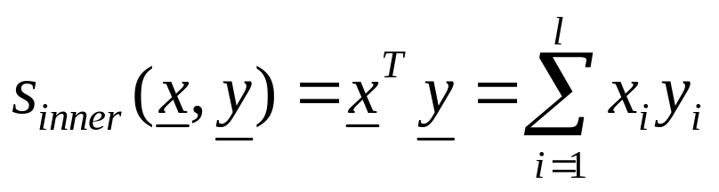
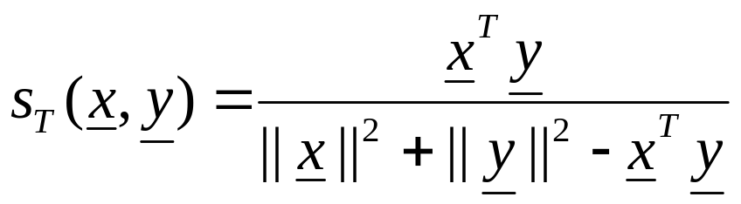
Proximity Measures Between Vectors
  Similarity measures
    Inner product
    Tanimoto measure

Slide 26

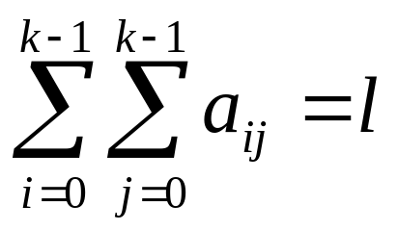
Proximity Measures Between Discrete-Valued Vectors
  Let F={0,1,…,k-1} be a set of symbols and X={x₁,…,x_{N}} ⊂ F^{l}
  Let A(x,y)=[a_{ij}], i, j=0,1,…,k-1, where a_{ij} is the number of places where x has the i-th symbol and y has the j-th symbol.
Example: l=6, k =3
NOTE:

Slide 27
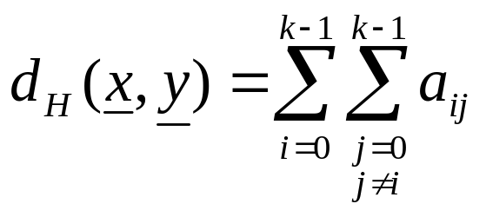
Proximity Measures Between Discrete-Valued Vectors
Several proximity measures can be expressed as combinations of the elements of A(x,y).
  Dissimilarity measures:
    The Hamming distance (number of places where x and y differ)

Slide 28
Proximity Measures Between Discrete-Valued Vectors
Several proximity measures can be expressed as combinations of the elements of A(x,y).
  Dissimilarity measures:
    The Hamming distance (number of places where x and y differ)

Slide 29
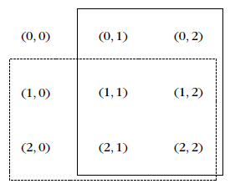
Proximity Measures Between Discrete-Valued Vectors
n_{y}
  Similarity measures:
n_{x}

Slide 30
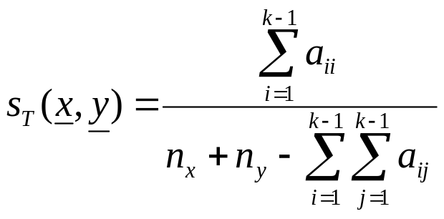
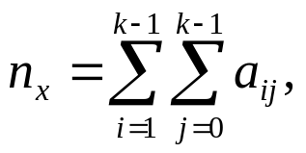
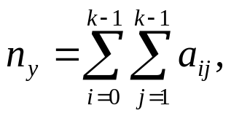
Proximity Measures Between Discrete-Valued Vectors
n_{y}
  Similarity measures:
n_{x}
    Tanimoto measure :
    where

Slide 31
Proximity Measures Between Discrete-Valued Vectors
n_{y}
  Similarity measures:
n_{x}
    Tanimoto measure :
    where

Slide 32
Proximity Measures Between Mixed-Valued Vectors
Some of the coordinates of the vectors x are real and the rest are discrete.
Methods for measuring the proximity between two such x_{i} and x_{j}:
  Adopt a proximity measure (PM) suitable for real-valued vectors.
  Convert the real-valued features to discrete ones and employ a discrete PM.
  The more general case of mixed-valued vectors:
  Here nominal, ordinal, interval-scaled, ratio-scaled features are treated separately.

Slide 33
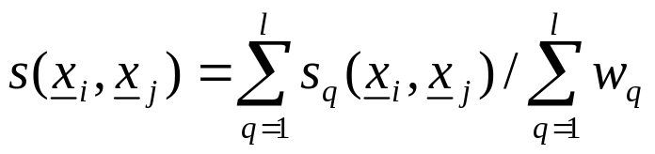
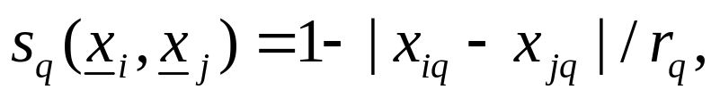
Proximity Measures Between Mixed-Valued Vectors
The similarity function between x_{i} and x_{j} is:
In the above definition:
  w_{q}=0, if one of the q-th coordinates of x_{i} and x_{j} are undefined or both the q-th coordinates are equal to 0. Otherwise w_{q}=1.
  If the q-th coordinates are binary, s_{q}(x_{i},x_{j})=1 if x_{iq}=x_{jq}=1 and 0 otherwise.
  If the q-th coordinates are nominal or ordinal, s_{q}(x_{i},x_{j})=1 if x_{iq}=x_{jq} and 0 otherwise.
  If the q-th coordinates are interval or ratio scaled-valued
  where r_{q} is the interval where the q-th coordinates of the vectors of the data set X lie.

Slide 34
Fuzzy Proximity Measures
Let x, y∈[0,1]^{l}. Here the value of the i-th coordinate, x_{i,} of x, is not the outcome of a measuring device.
  The closer the coordinate x_{i} is to 1 (0), the more likely the vector x possesses (does not possess) the i-th characteristic.
  As x_{i} approaches 0.5, the certainty about the possession or not of the i-th feature from x decreases.

Slide 35
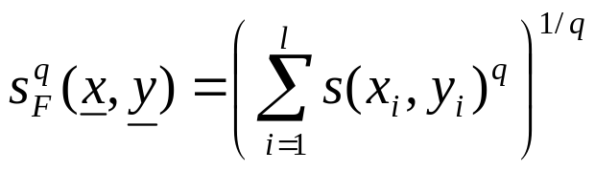
Fuzzy Proximity Measures
A possible similarity measure that can quantify the above is:
Then

Slide 36
Proximity Measures For Missing Data
For some vectors of the data set X, some features values are unknown
Ways to face the problem:
  Discard all vectors with missing values (not recommended for small data sets)
  Find the mean value m_{i} of the available i-th feature values over that data set and substitute the missing i-th feature values with m_{i}.

Slide 37
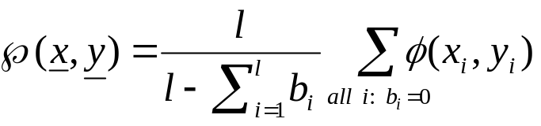
Proximity Measures For Missing Data
  Define b_{i}=0, if both the i-th features x_{i}, y_{i} are available and b_{i}=1 otherwise. Then
  where φ(x_{i},y_{i}) denotes the PM between two scalars x_{i}, y_{i}.

Slide 38
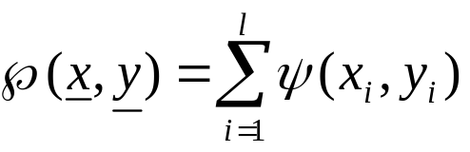
Proximity Measures For Missing Data
  Find the average proximities φ_{avg}(i) between all feature vectors in X along all components. Then
  where ψ(x_{i},y_{i})=φ(x_{i},y_{i}), if both x_{i} and y_{i} are available and φ_{avg}(i) otherwise.

Slide 39
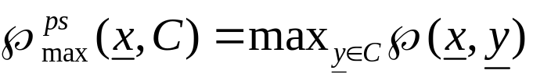

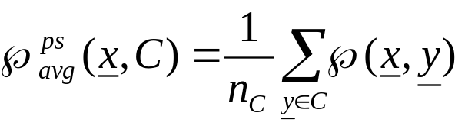
Proximity Functions Between A Vector and A Set
Let X={x₁,x₂,…,x_{N}} and C ⊂ X, x ∈ X
All points of C contribute to the definition of ℘(x, C)
  Max proximity function
  Min proximity function
  Average proximity function
(n_{C} is the cardinality of C)

Slide 40
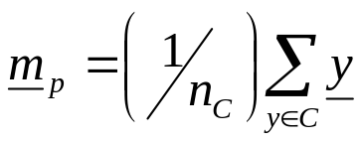
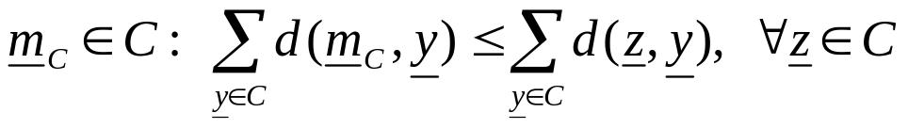
A representative(s) of C, r_{C} , contributes to the definition of ℘(x,C)
In this case: ℘(x,C)=℘(x,r_{C})
Typical representatives are:
  The mean vector:
  The mean center:
  The median center:
NOTE: Other representatives (e.g., hyperplanes, hyperspheres) are useful in certain applications (e.g., object identification using clustering techniques).
where n_{C} is the cardinality of C
d: a dissimilarity measure

Slide 41
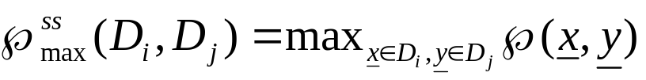

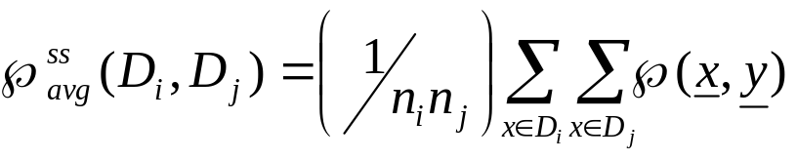
Proximity Functions Between Sets
Let X={x₁,…,x_{N}}, D_{i}, D_{j} ⊂ X and n_{i}=|D_{i}|, n_{j}=|D_{j}|
All points of each set contribute to ℘(D_{i},D_{j})
  Max proximity function
  Min proximity function
  Average proximity function

Slide 42

Proximity Functions Between Sets
Each set D_{i} is represented by its representative vector m_{i}
  Mean proximity function (it is a measure provided that ℘ is a measure):

Slide 43
Remarks:
  Different choices of proximity functions between sets may lead to totally different clustering results.
  Different proximity measures between vectors in the same proximity function between sets may lead to totally different clustering results.
  The only way to achieve a proper clustering is
    by trial and error and,
    taking into account the opinion of an expert in the field of application.

